Slide 1
Vehicular Accidents Effects on Traffic
Created by: Utsav Patel(upp10)
Sneh Desai(sd1324)
Manan Vakta(mv651)
Harshal Sinha(hs1030)

Slide 2
Motivation and Goal
There are around 6 million vehicular accidents every year in the U.S.A. 90 people everyday die because of accidents and around 3 million people are injured every year by the same.
It would benefit a significant portion of population by reducing the number of accidents.
We can do this by finding the most contributing factors in the ‘severity’ of an accident.
By identifying and controlling these factors, we might be able to reduce the overall severity of an accident.
Goal is to find those important features according to different severities of the accidents.

Slide 3
Data Source
This Data set contains data from accidents from all around the USA.
Data obtained from Kaggle.com - collected from February 2016 to December2020 using multiple APIs that provide streaming traffic incident (or event) data.
There are about 1.5 million accident records in this dataset.
Each row contains 47 different features of different categories such as:
12 traffic attributes severity, start time of the accident, end time, length of road extent affected by accident, etc..
9 address attributes like street number, side, city, country, state, zip code, time zone, etc.
11 weather attributes like temperature, humidity, pressure, visibility, etc.
12 POI attributes like bump, crossing, railway, stop, no_exit, traffic signal, etc.

Slide 4
Data Preprocessing
Drop features recorded after the accident has occurred like length of road impacted by the accident, end time, TMC code, ID code, Duration.
Remove ‘country’ and ‘turning loop’ feature as they contain 1 unique value-USA and False.
Wind direction contains many redundant values as SW,SSW, South, NW, NNW, North, etc. We clean it to contain only ‘CALM’ ,'SW’ , 'S’ , ‘W’, 'NW’, 'N’ ,'VAR’ ,'SE’ ,'E’, 'NE’ ,nan] values.
Weather condition contained 117 different values which were reduced to 7 values namely: ’Clear’, ’Cloud’, ’Rain’, ’HeavyRain’, ’Snow’,’HeavySnow’ and ’Fog’.
Separate features were created out of 7 values.

Slide 5
Data Preprocessing (Continue)
Difference between start_time_feature and weather_timestamp is average 1 min. Drop weather_timestamp.
Street number has more than 60% of NAN Values so drop.
Precipitation and wind chill contains 30% NAN and are important features. Drop those rows where NAN appears.
Group remaining small missing data points by airport code and month and fill in median of the values. Remove all the left missing datapoints.
Severity 1 = 25620 Severity 2 = 808545 Severity 3 = 68206 Severity 4 = 45691. Data is skewed towards Severity 2. Severity 1 is very low and less important so drop rows with severity 1.
Undersample data and take 45691 values from each severity.

Slide 6
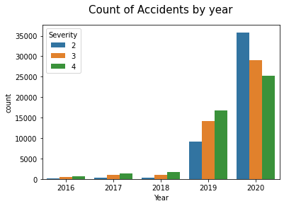
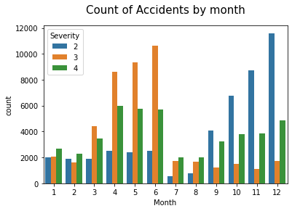
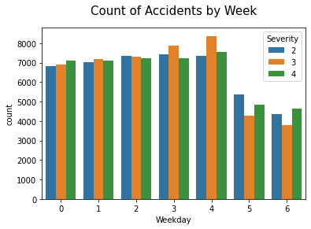
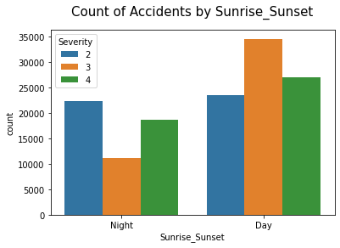
Data Analysis(Time features)

Slide 7
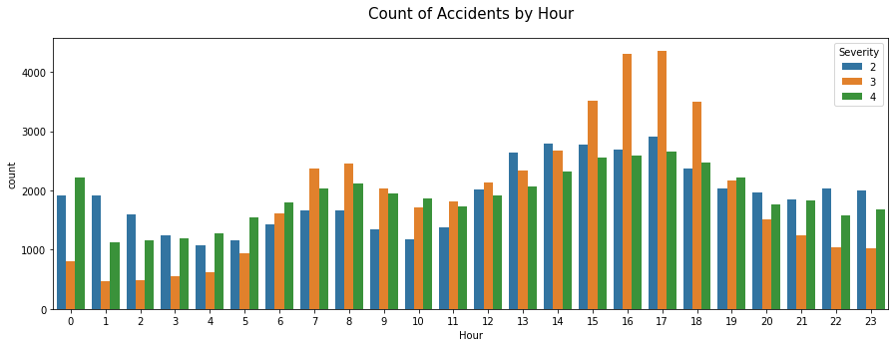
Data Analysis(Time features- HOURS)

Slide 8
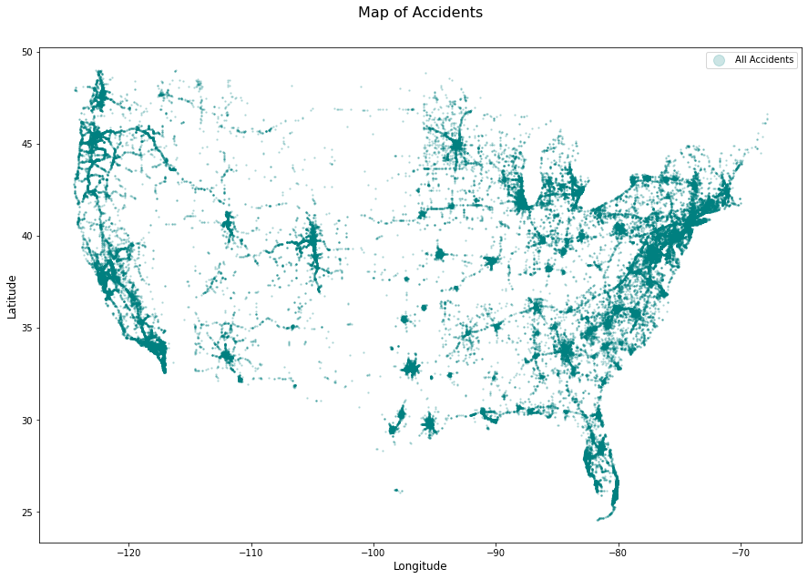
Data Analysis(Location Features)

Slide 9
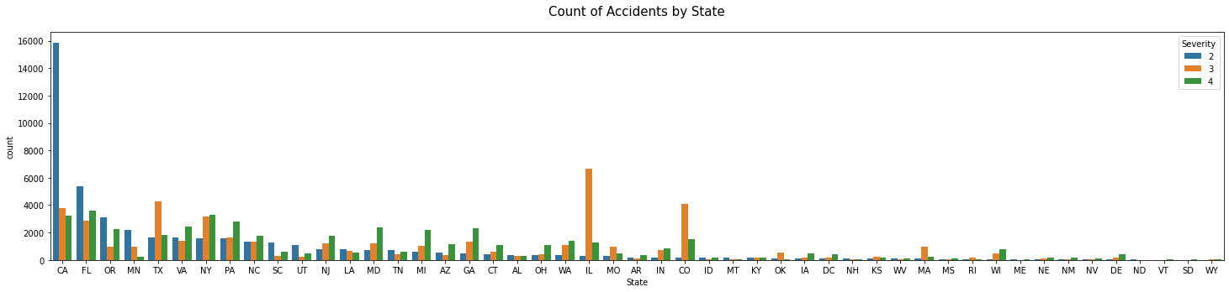
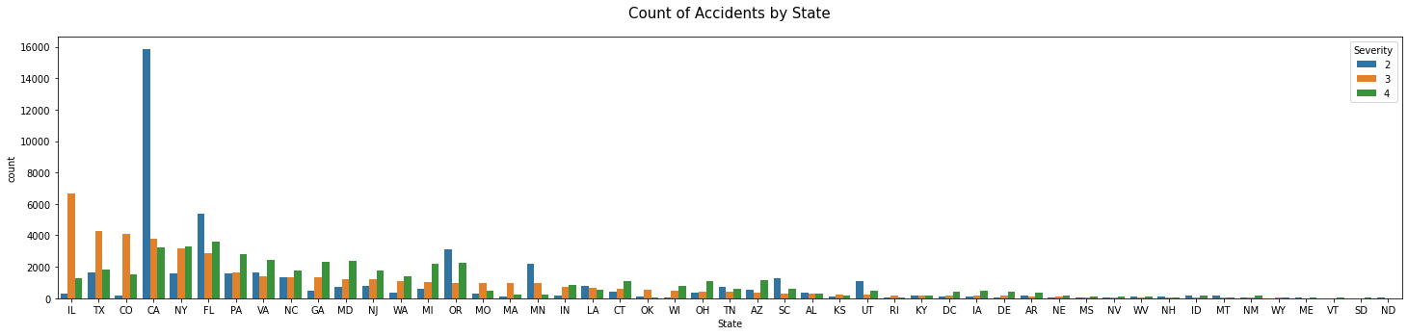
Data Analysis(Location- Severity 2 and 3)

Slide 10
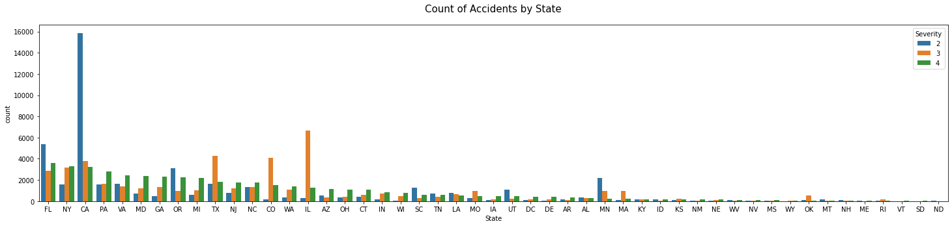
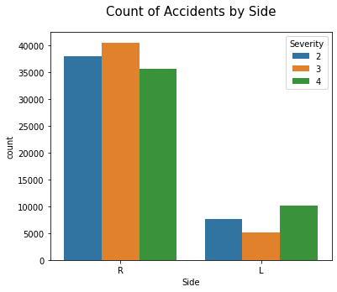
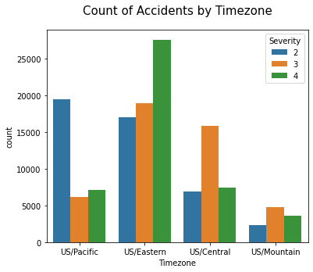
Data Analysis(Location- Severit4, Side and time zone)

Slide 11
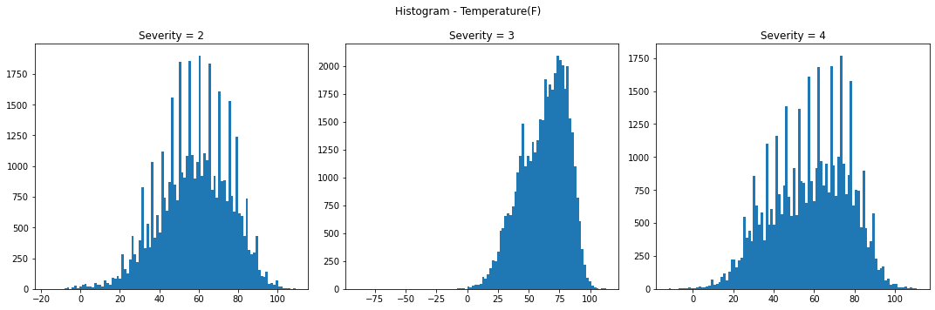
Data Analysis(Weather Features- temperature)

Slide 12
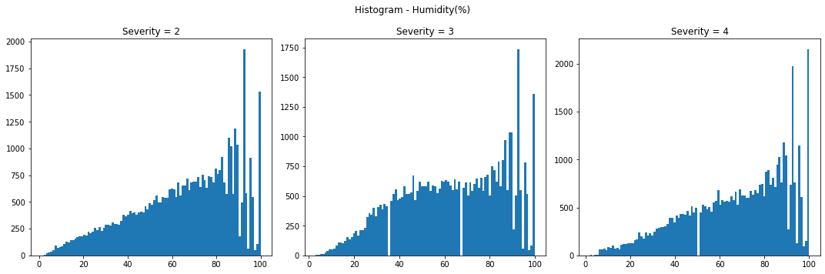
Data Analysis(Weather Features- humidity)

Slide 13
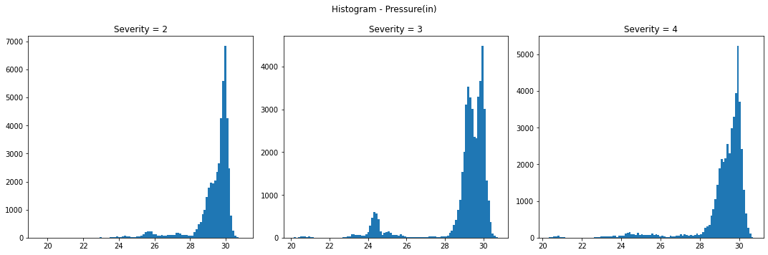
Data Analysis(Weather Features- Pressure)

Slide 14
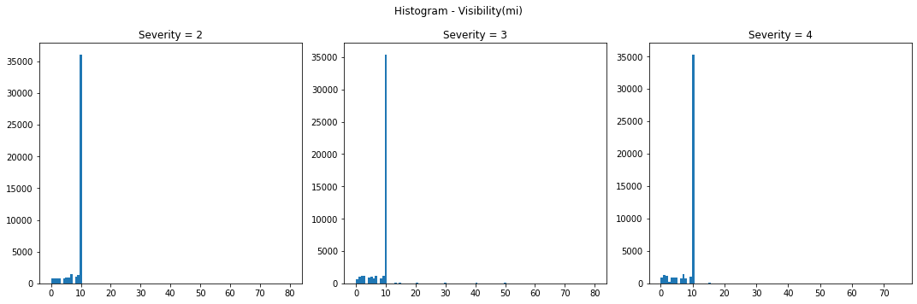
Data Analysis(Weather Features- Visibility)

Slide 15
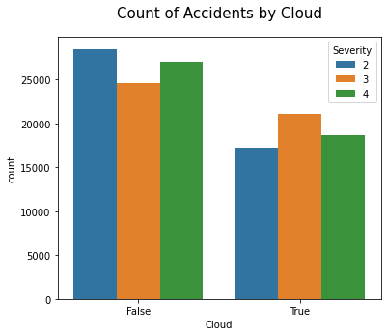
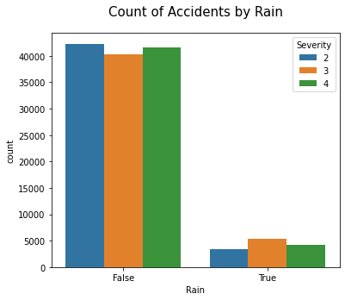
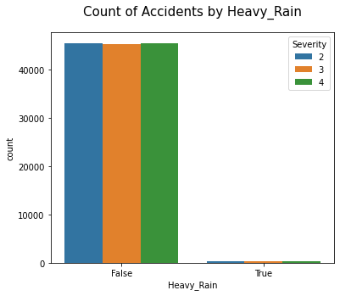
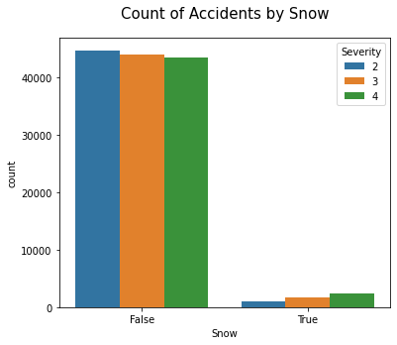
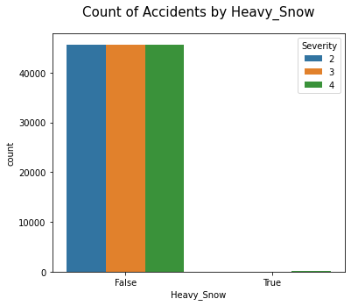
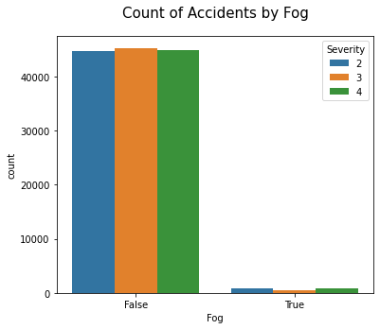
Data Analysis(Discrete Binary Weather features)

Slide 16
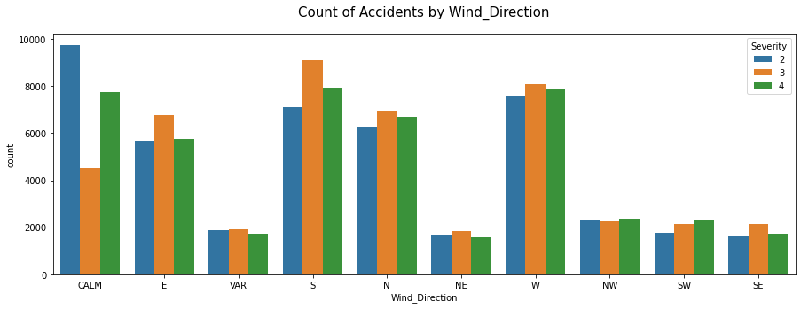
Data Analysis(Wind direction)

Slide 17
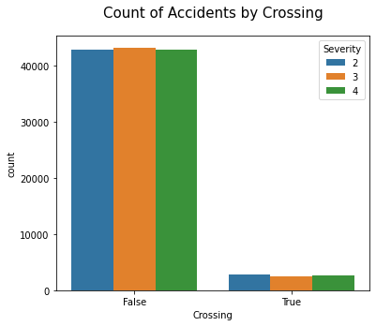
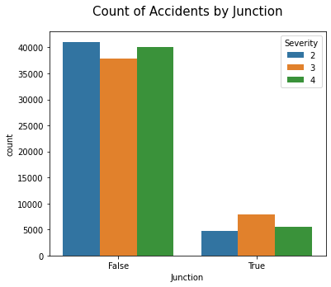
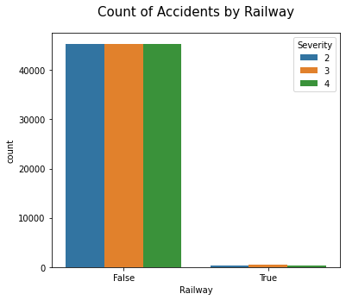
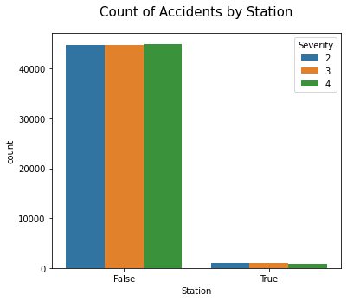
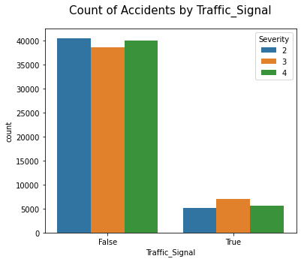
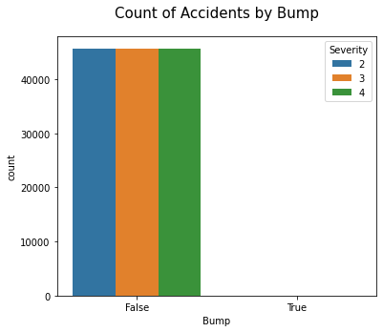
Data Analysis(POI Features) less important Features

Slide 18
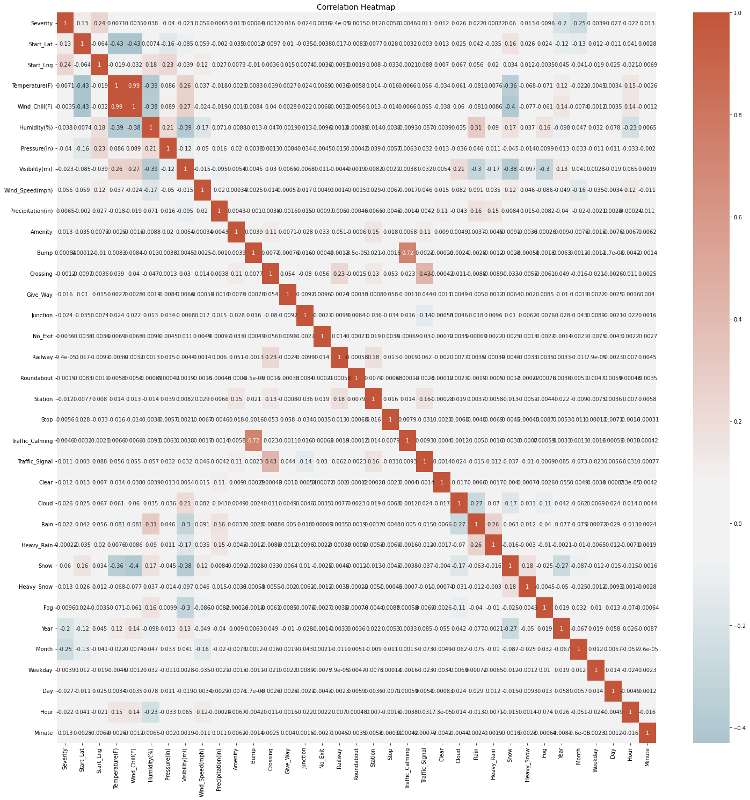
Data Analysis- Correlation Analysis

Slide 19
Data balancing and size of data for models.
Drop Start_Time because of datatype datetime64[ns]: Made into year, week, day, hour, minute.
Drop other features like street, city, country, state, zipcode, etc. because we made it to latitude longitude features.
Make True or False, Day or Night and R and L to 1 or 0.
One hot encode the features Time zone and Weekday.
Original data shape (137073, 50) split into:
Training input shape (134331, 49)
Training output shape (134331,)
Testing input shape (2742, 49)
Testing output shape (2742,)

Slide 20
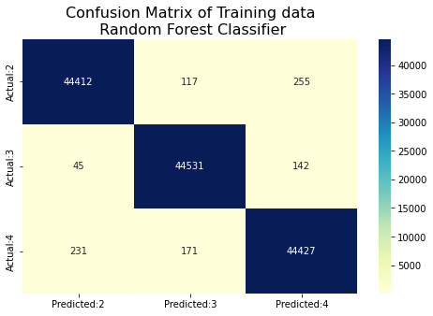
Random forest Classifier:
Optimal parameters RandomForestClassifier(max_depth=33, max_features='sqrt', n_estimators=46)
Best score 0.7733247806027291 and Number of splits 5
Training Accuracy: 0.9928460295836404
 | Precision | Recall | F1-score | Support
2 | 0.99 | 0.99 | 0.99 | 44784
3 | 0.99 | 1.0 | 0.99 | 44718
4 | 0.99 | 0.99 | 0.99 | 44829
Accuracy |  |  | 0.99 | 134331
Macro average | 0.99 | 0.99 | 0.99 | 134331
Weighted Average | 0.99 | 0.99 | 0.99 | 134331

Slide 21
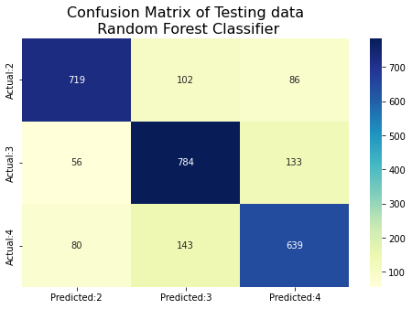
Random forest Classifier(Continue)
Testing Accuracy: 7811816192560175
 | Precision | Recall | F1-score | Support
2 | 0.84 | 0.79 | 0.82 | 907
3 | 0.76 | 0.81 | 0.78 | 973
4 | 0.74 | 0.74 | 0.74 | 862
Accuracy |  |  | 0.78 | 2742
Macro average | 0.78 | 0.78 | 0.78 | 2742
Weighted Average | 0.78 | 0.78 | 0.78 | 2742

Slide 22
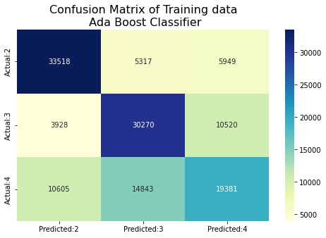
ADA Boost Classifier
Optimal parameters: AdaBoostClassifier(n_estimators=83)
Best score: 0.6120104106813583 and Number of splits: 5.
Training Accuracy: 0.619134823681801
 | Precision | Recall | F1-score | Support
2 | 0.70 | 0.75 | 0.72 | 44784
3 | 0.60 | 0.68 | 0.64 | 44718
4 | 0.54 | 0.43 | 0.48 | 44829
Accuracy |  |  | 0.62 | 134331
Macro average | 0.61 | 0.62 | 0.61 | 134331
Weighted Average | 0.61 | 0.62 | 0.61 | 134331

Slide 23
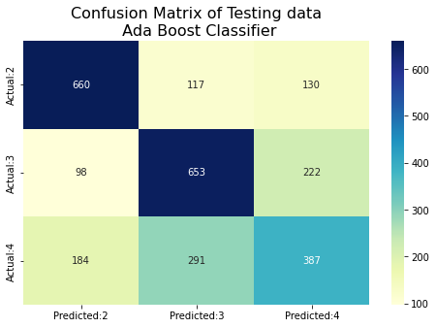
ADA Boost Classifier(Continue)
Testing Accuracy: 0.6199854121079504
 | Precision | Recall | F1-score | Support
2 | 0.70 | 0.73 | 0.71 | 907
3 | 0.62 | 0.67 | 0.64 | 973
4 | 0.52 | 0.45 | 0.48 | 862
Accuracy |  |  | 0.62 | 2742
Macro average | 0.61 | 0.62 | 0.61 | 2742
Weighted Average | 0.61 | 0.62 | 0.61 | 2742

Slide 24
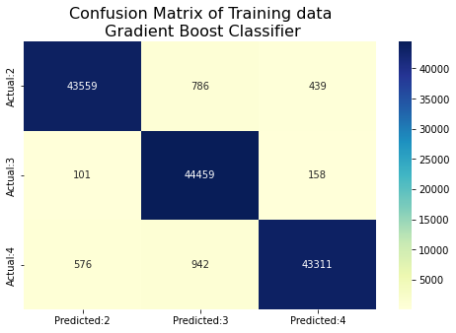
Gradient Boosting classifier
GradientBoostingClassifier(max_depth=13, max_features='sqrt', n_estimators=120)
Training Accuracy: 0.9776522172841712
 | Precision | Recall | F1-score | Support
2 | 0.98 | 0.97 | 0.98 | 44784
3 | 0.96 | 0.99 | 0.98 | 44718
4 | 0.99 | 0.97 | 0.98 | 44829
Accuracy |  |  | 0.98 | 134331
Macro average | 0.98 | 0.98 | 0.98 | 134331
Weighted Average | 0.98 | 0.98 | 0.98 | 134331

Slide 25
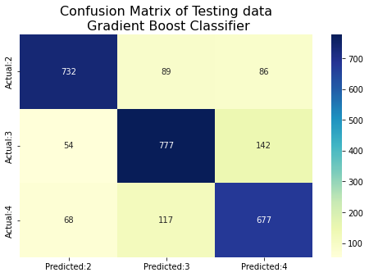
Gradient Boosting Classifier(Continue)
Testing Accuracy: 0.7972283005105762
 | Precision | Recall | F1-score | Support
2 | 0.86 | 0.81 | 0.83 | 907
3 | 0.79 | 0.80 | 0.79 | 973
4 | 0.75 | 0.79 | 0.77 | 862
Accuracy |  |  | 0.80 | 2742
Macro average | 0.80 | 0.80 | 0.80 | 2742
Weighted Average | 0.80 | 0.80 | 0.80 | 2742

Slide 26
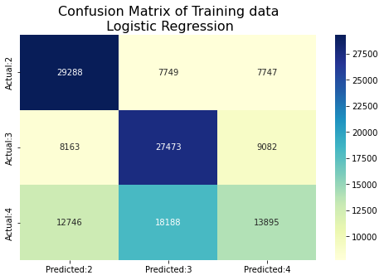
Logistic regression
Training Accuracy: 0.5259843223083279
 | Precision | Recall | F1-score | Support
2 | 0.58 | 0.65 | 0.62 | 44784
3 | 0.51 | 0.61 | 0.67 | 44718
4 | 0.45 | 0.31 | 0.37 | 44829
Accuracy |  |  | 0.53 | 134331
Macro average | 0.52 | 0.53 | 0.51 | 134331
Weighted Average | 0.52 | 0.53 | 0.51 | 134331

Slide 27
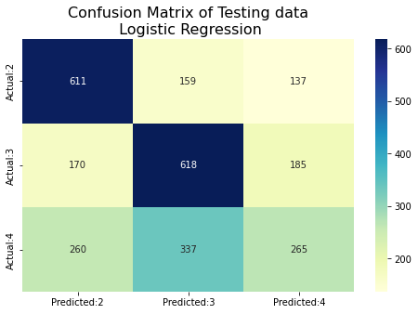
Logistic Regression (Continue)
Testing Accuracy: 0.5448577680525164
 | Precision | Recall | F1-score | Support
2 | 0.59 | 0.67 | 0.63 | 907
3 | 0.55 | 0.64 | 0.59 | 973
4 | 0.45 | 0.31 | 0.37 | 862
Accuracy |  |  | 0.54 | 2742
Macro average | 0.53 | 0.54 | 0.53 | 2742
Weighted Average | 0.53 | 0.54 | 0.53 | 2742

Slide 28
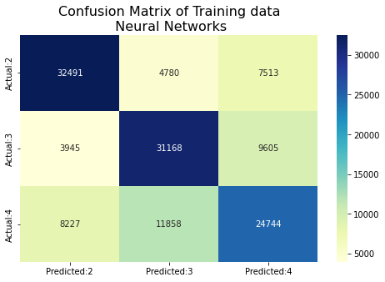
Neural Networks
5 Hidden layers. Size: 256,128,64,32,16.
ReLU Activation function and Adam Optimizer.
Training Accuracy: 0.6580982796227229
 | Precision | Recall | F1-score | Support
2 | 0.73 | 0.73 | 0.73 | 44784
3 | 0.65 | 0.70 | 0.67 | 44718
4 | 0.59 | 0.55 | 0.57 | 44829
Accuracy |  |  | 0.66 | 134331
Macro average | 0.66 | 0.66 | 0.66 | 134331
Weighted Average | 0.66 | 0.66 | 0.66 | 134331

Slide 29
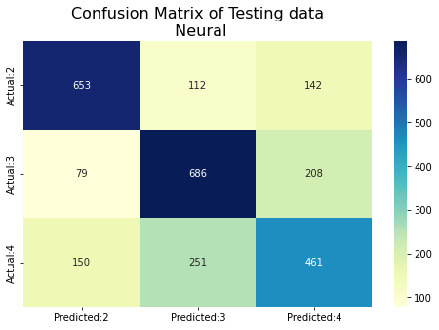
Neural Networks(Continue)
Testing Accuracy: 0.6564551422319475
 | Precision | Recall | F1-score | Support
2 | 0.74 | 0.72 | 0.73 | 907
3 | 0.65 | 0.71 | 0.68 | 973
4 | 0.57 | 0.53 | 0.55 | 862
Accuracy |  |  | 0.66 | 2742
Macro average | 0.65 | 0.65 | 0.65 | 2742
Weighted Average | 0.66 | 0.66 | 0.66 | 2742

Slide 30
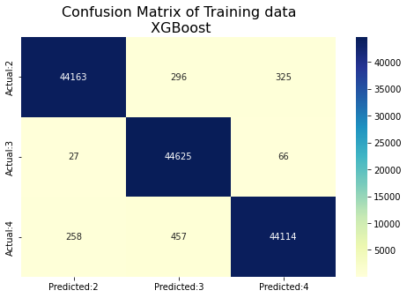
xgboost
Training Accuracy: 0.9893620981009595
 | Precision | Recall | F1-score | Support
2 | 0.99 | 0.99 | 0.99 | 44784
3 | 0.98 | 1.0 | 0.99 | 44718
4 | 0.99 | 0.98 | 0.99 | 44829
Accuracy |  |  | 0.99 | 134331
Macro average | 0.99 | 0.99 | 0.99 | 134331
Weighted Average | 0.99 | 0.99 | 0.99 | 134331

Slide 31
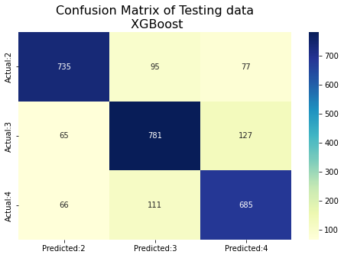
XGBOOSt(Continue)
Testing Accuracy: 0.8026987600291758
 | Precision | Recall | F1-score | Support
2 | 0.85 | 0.81 | 0.83 | 907
3 | 0.79 | 0.80 | 0.80 | 973
4 | 0.77 | 0.79 | 0.78 | 862
Accuracy |  |  | 0.80 | 2742
Macro average | 0.80 | 0.80 | 0.80 | 2742
Weighted Average | 0.80 | 0.80 | 0.80 | 2742

Slide 32
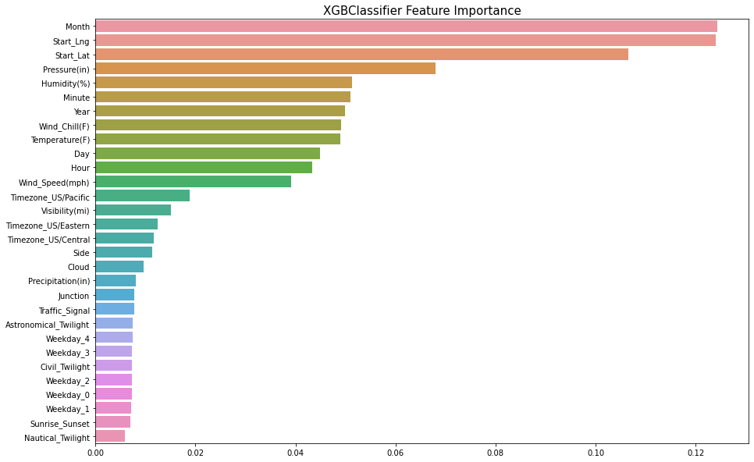
XGBoost Classifier feature Importance

Slide 33
Conclusion
Ways to prevent severe accidents:
Build bigger and safer roads in densely populated areas so that the risk of accidents is lower.
Making sure roads and cars are properly equipped to handle bad weather conditions.
Avoiding travel unless necessary in extreme weather conditions.
Building better infrastructure to help work time rush hour traffic.

Slide 34
Question?

Slide 35
Thank You

Slide 36
References
Dataset: https://www.kaggle.com/sobhanmoosavi/us-accidents
RandomForestClassifier - https://scikitlearn.org/stable/modules/generated/sklearn.ensemble.RandomForestClassifier.html
AdaBoostClassifier - https://scikitlearn.org/stable/modules/generated/sklearn.ensemble.AdaBoostClassifier.html
GradientBoostClassifier - https://scikitlearn.org/stable/modules/generated/sklearn.ensemble.GradientBoostingClassifier.html
NeuralNetworks - https://scikit-learn.org/stable/modules/generated/sklearn.neural_network.MLPClassifier.html
Logistic Regression - https://scikitlearn.org/stable/modules/generated/sklearn.linear_model.LogisticRegression.html
XGBoostClassifier - https://scikitlearn.org/stable/modules/generated/sklearn.ensemble.GradientBoostingClassifier.html

